Slide 1
MANTID Architecture Overview

Slide 2
Overview
Introduce where mantid fits in within facility ecosystem
Describe general architecture of system
Overview of where mantid runs

Slide 3
Manipulation and ANalysis Toolkit for Instrument Data
A high performance computation framework for scientific data.
Manipulate and analyse Neutron and Muon data.
Neutron Scattering
Diffraction, spectroscopy, small angle, reflectometry
Muon Spectroscopy
Could be applied to other techniques
Open Source
Advanced graphing and visualisation UI.
Multiple Platforms

Slide 4
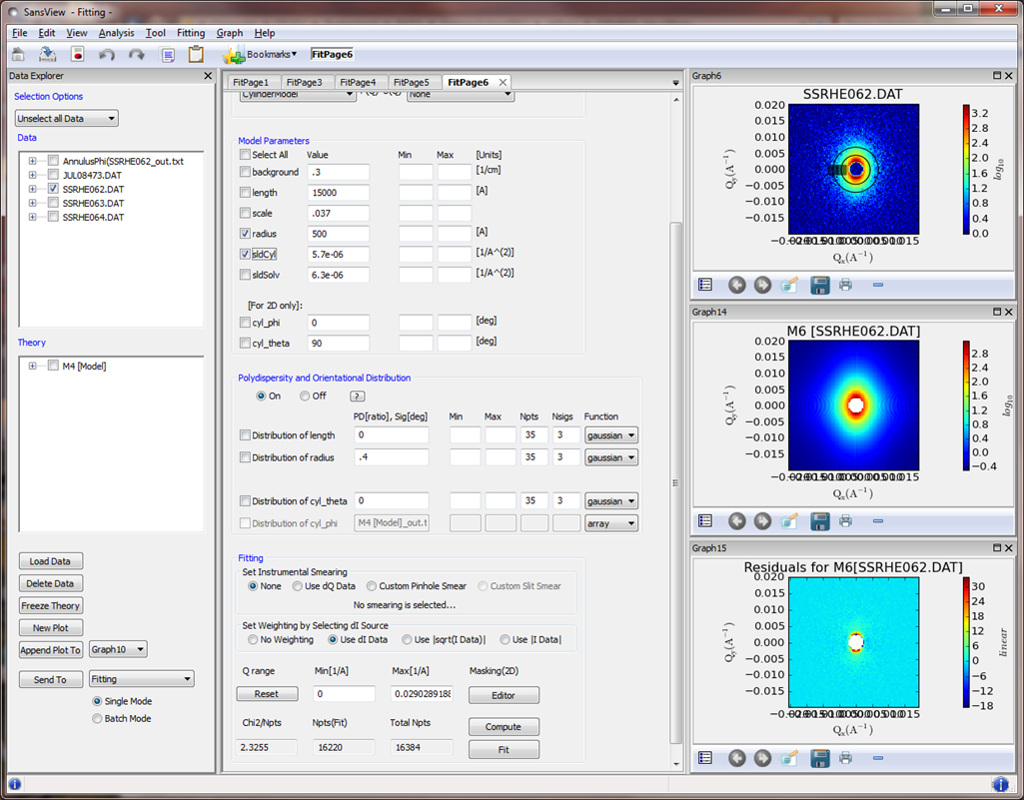
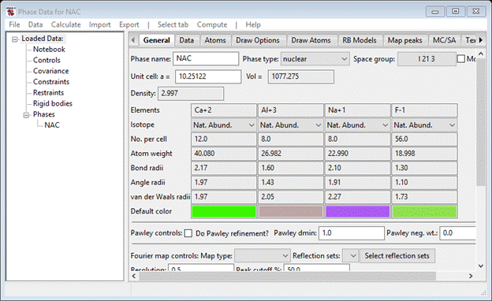
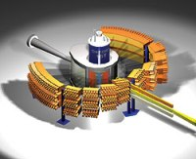
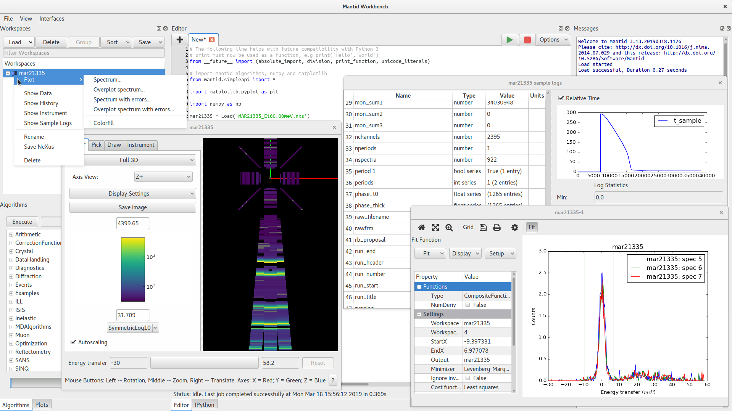

Facility Ecosystem
Other analysis programs...
Data Collection
NeXus/RAW File
Mantid
Live Data

Slide 5
Mantid Architecture
Science Interfaces
Plotting
...
Web apps
(Separate Projects)
MantidPlot
(Qt4)
MantidWorkbench
(Qt5)
Frontend UI
C++ API
Python API
Autoreduction
(Separate Project)
Data In
Framework
Backend
(Domain logic)
Instrument
Workspaces
Algorithms
Instrument
...

Slide 6
Environments (where is mantid running)
Official support for:
Windows
RedHat 7/CentOS 7
Ubuntu 16.04/18.04
MacOS 10.10+
Installable to any users machines
Used by Autoreduction service for automatic processing of data as it is collected
Installed in new ISIS Data Analysis as a Service (IDAaaS) platform
Installed in legacy ISISCompute platform

Slide 7
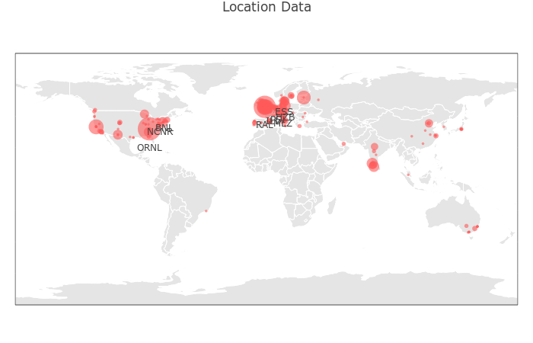

Slide 8
Summary
MANTID is designed to be flexible and integrate with other software/systems
MANTID is mission critical software for many facilities

